Slide 1

WELCOME
Mobile Application Development

Slide 2

Android Architecture
Mobile Application Development
Lecture # 7
Instructor: Muhammad Naeem Khan

Slide 3
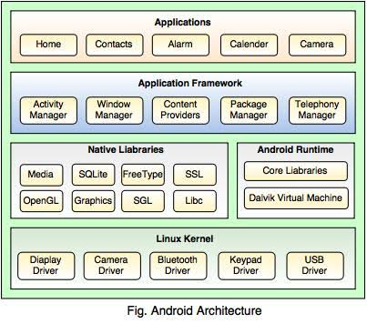
Android Architecture

Slide 4

Linux kernel
It is like heart of android operating system and present at the bottom of android architecture.
It contains essential hardware drivers like display, audio, camera, Bluetooth, Wi-Fi etc..
It also provide functionalities such as power management, process management and memory management.
It provide a level of abstraction between device hardware and upper layers of android stack.

Slide 5
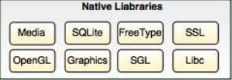
Libraries
Above Linux kernel there are native libraries such as SQLite, Web-kit, Open-GL, SSL etc.
SQLite – It provide various classes used for database management.
Web-Kit – it is a web browser engine used to display Internet content.
SSL – it provides Internet security.
Open-GL – it is a Java interface to the OpenGL ES 3D graphics rendering API.

Slide 6
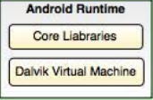
Android Run Time
It is a third section which is also present on the second layer from bottom of Android Architecture.
Android runtime provides core libraries and Dalvik virtual Machine(DVM).
These core libraries enable Android developers to write Android applications using standard Java programming language.
DVM is a major component of Android OS. It is same like Java Virtual Machine.
DVM is responsible for running Android applications. It consumes less memory and provides very fast performance.

Slide 7

Application Framework
It is the fourth section and third layer present on the top of native libraries and android runtime.
It provides various API’s like activity manager, resource manager, content provider, telephony manager etc.
These API’s are used by Android application developers.

Slide 8

Application Framework
Applications layer is present at the top. Various applications created by developers like games, contacts and browsers are installed on this layer.

Slide 9
Thank You

